Slide 1
IBM University Engagement Project Submission
“Exploring the Power of Agentic AI with IBM Granite and IBM Bob”

Slide 2
Project Tile – Agentic AI for Mental Health Awareness & Suicide Prevention
Domain of Project – Healthcare
Student Name | Recent Passport Photo | Email ID | Mobile number [WhatsApp]
Khushi Gupta |  | khushigupta83670@gmail.com | 7060388522

Slide 3
Problem Statement -
The Challenge
Mental health issues such as depression, anxiety, and suicidal thoughts are growing worldwide. Stigma, lack of awareness, and limited access to timely help prevent many individuals from seeking support. Traditional systems are often reactive, leaving gaps in early detection and preventive care.
The Objective
Build an Agentic AI-powered Mental Health Awareness & Suicide Prevention Agent that is empathetic, proactive, and safe. The solution should:
Promote Awareness & Education – Share accessible resources on mindfulness, coping strategies, and self-care.
Enable Early Detection (RAG) – Use Retrieval-Augmented Generation to identify distress signals in conversations, journaling inputs, or safe online data.
Provide Empathetic Support – Build a conversational agent that listens actively and responds with empathy (with clear disclaimers: not a substitute for professional medical advice).
Predict & Prevent Risks – Forecast stress peaks, suggest preventive strategies, and issue alerts when high-risk signals are detected (with consent).
Connect to Human Support – Link users to helplines, counselors, or community support for timely intervention.
Tech Stack (Mandatory)
IBM Langflow / IBM Orchestrate + IBM Models

Slide 4
Proposed Solution : AI-Powered Agentic Mental Health Companion
The proposed solution is a multi-agent AI-powered Mental Health Awareness & Suicide Prevention platform built using IBM watsonx.ai, IBM Granite Models, IBM Langflow/IBM Orchestrate, Spring Boot, React.js, and MySQL. The platform provides personalized emotional support, mental health awareness, early risk detection, and proactive wellness recommendations through an intelligent AI companion.
At its core, the solution uses a Retrieval-Augmented Generation (RAG) architecture to retrieve accurate and trusted mental health information from verified resources. The retrieved knowledge is embedded into a vector database, allowing the AI to deliver context-aware, personalized, and reliable responses while maintaining conversational memory and user context.
Emotion Detection Agent analyzes user conversations, mood logs, and journal entries to identify emotions such as stress, anxiety, sadness, or happiness using sentiment analysis.
Personalized Recommendation Agent generates customized wellness plans, including breathing exercises, meditation sessions, self-care activities, motivational content, and educational resources based on the user's emotional state.
Wellness Tracking Agent maintains mood history, daily journals, wellness scores, activity streaks, and personalized progress reports, enabling users to monitor their mental well-being over time through an interactive dashboard.
The solution includes a modern, user-friendly dashboard built with React.js that enables users to record daily moods, maintain digital journals, interact with the AI companion, visualize mood trends, access mental health resources, and receive personalized recommendations in real time.
Spring Boot provides secure RESTful APIs with JWT-based authentication, while MySQL stores user profiles, chat history, mood records, journals, assessments, and wellness analytics. IBM watsonx.ai powers intelligent reasoning and natural language understanding, Granite Models generate empathetic responses and personalized recommendations, and IBM Langflow/IBM Orchestrate coordinates the complete multi-agent workflow and AI decision-making process.

Slide 5
Technology Used
IBM Langflow / IBM Orchestrate – Used to design, manage, and orchestrate multi-agent AI workflows, enabling seamless collaboration between Emotion Detection, Risk Assessment, Recommendation, and Emergency Support agents.
IBM Granite Models (e.g., granite-3.3-8b-instruct) – Used for natural language understanding, empathetic conversations, reasoning, summarization, emotion analysis, and personalized mental health recommendations.
IBM watsonx.ai – Provides AI model deployment, prompt engineering, embeddings, AI governance, and scalable model management for secure and responsible AI-powered mental health assistance.
Retrieval-Augmented Generation (RAG) – Retrieves trusted mental health information from verified resources before generating responses, ensuring accurate, reliable, and context-aware guidance.
Vector Database (ChromaDB / FAISS) – Stores document embeddings for fast semantic search and efficient retrieval of mental health articles, coping strategies, and wellness resources.
Spring Boot – Used to build secure RESTful APIs, implement business logic, integrate AI services, and provide JWT-based authentication for the application.
React.js & Tailwind CSS – Used to develop a modern, responsive, and interactive user interface, including the dashboard, AI chat, mood tracker, journaling, and wellness analytics.
MySQL Database – Stores user profiles, mood history, journal entries, chat history, assessments, emergency contacts, and wellness analytics in a secure and structured manner.
JWT & Spring Security – Ensures secure user authentication, role-based authorization, password encryption, and protected API access.

Slide 6
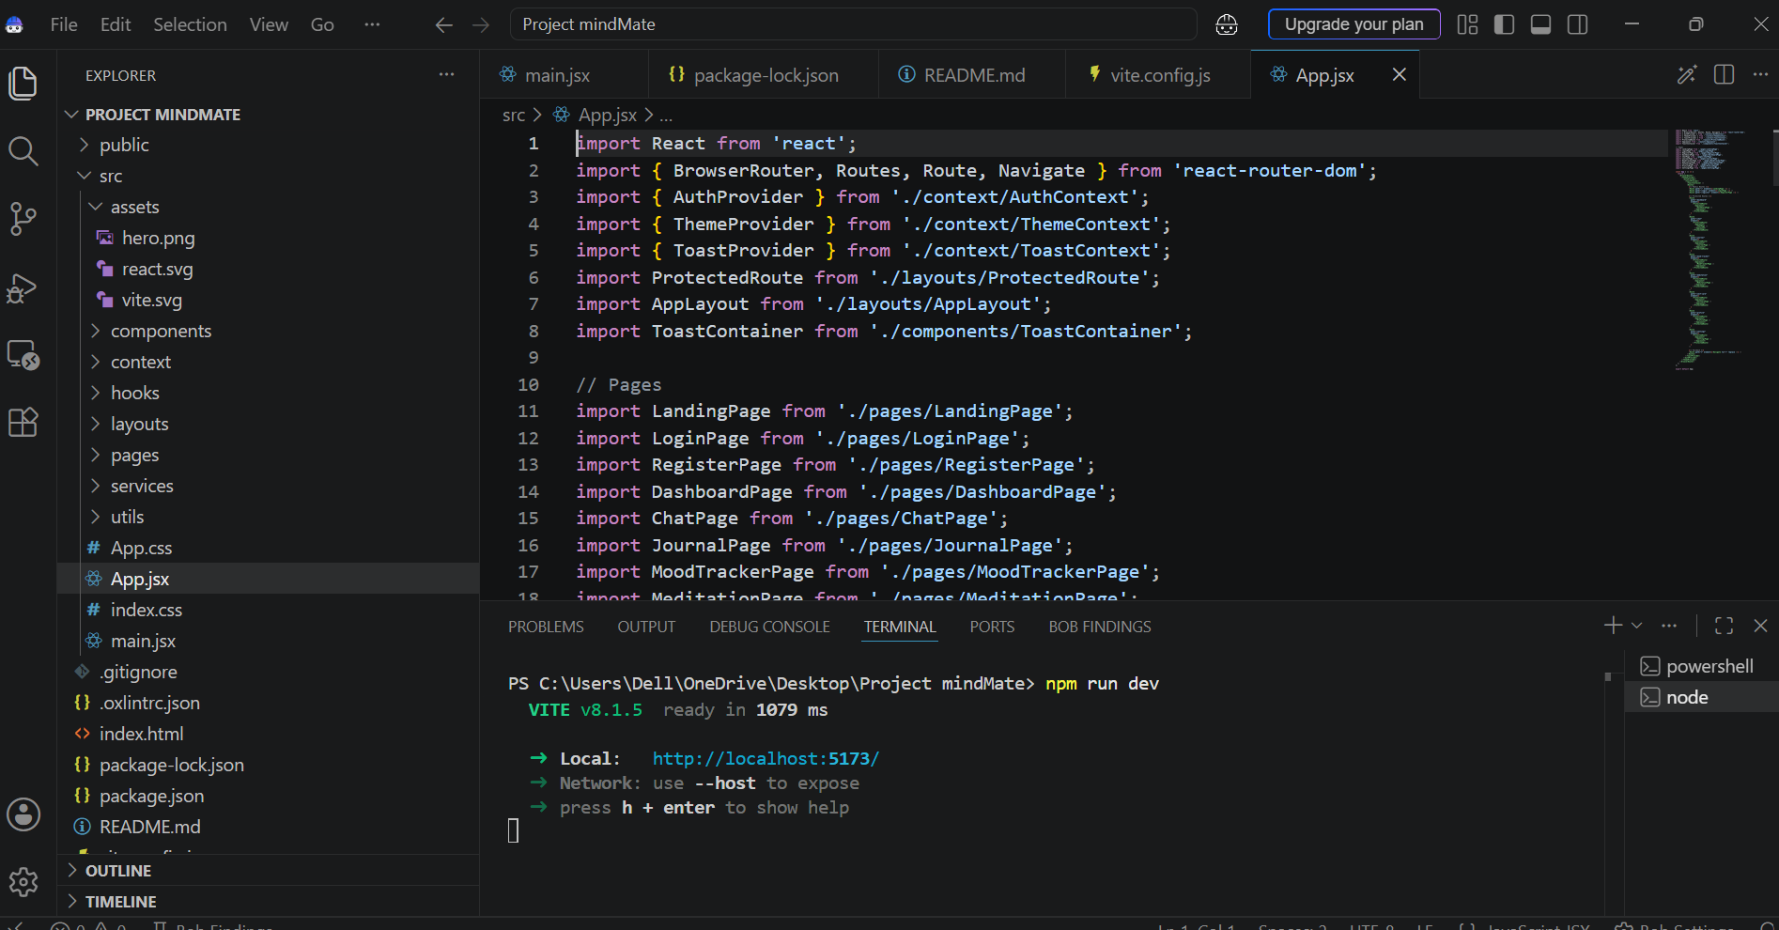
Required Files created using IBM bob -
App.py
Requirements.txt
Style.css
.env
Index.html

Slide 7
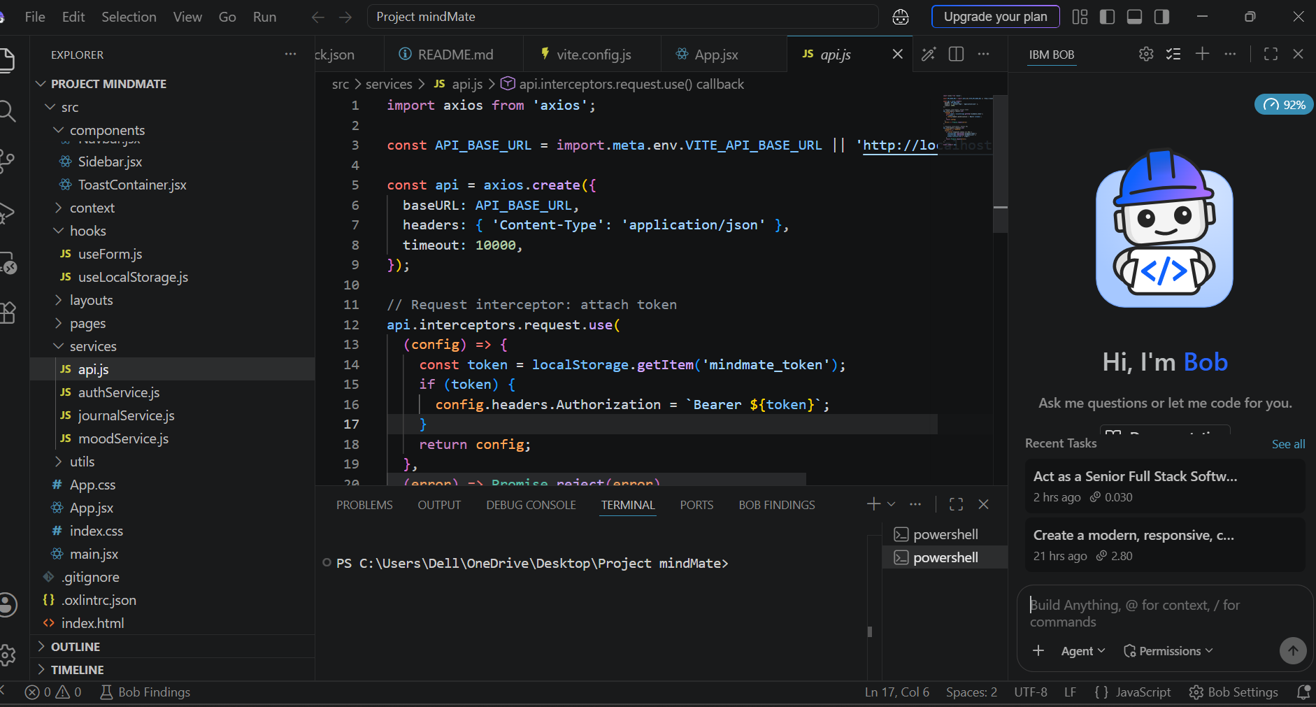
IBM Bob Screenshots:

Slide 8
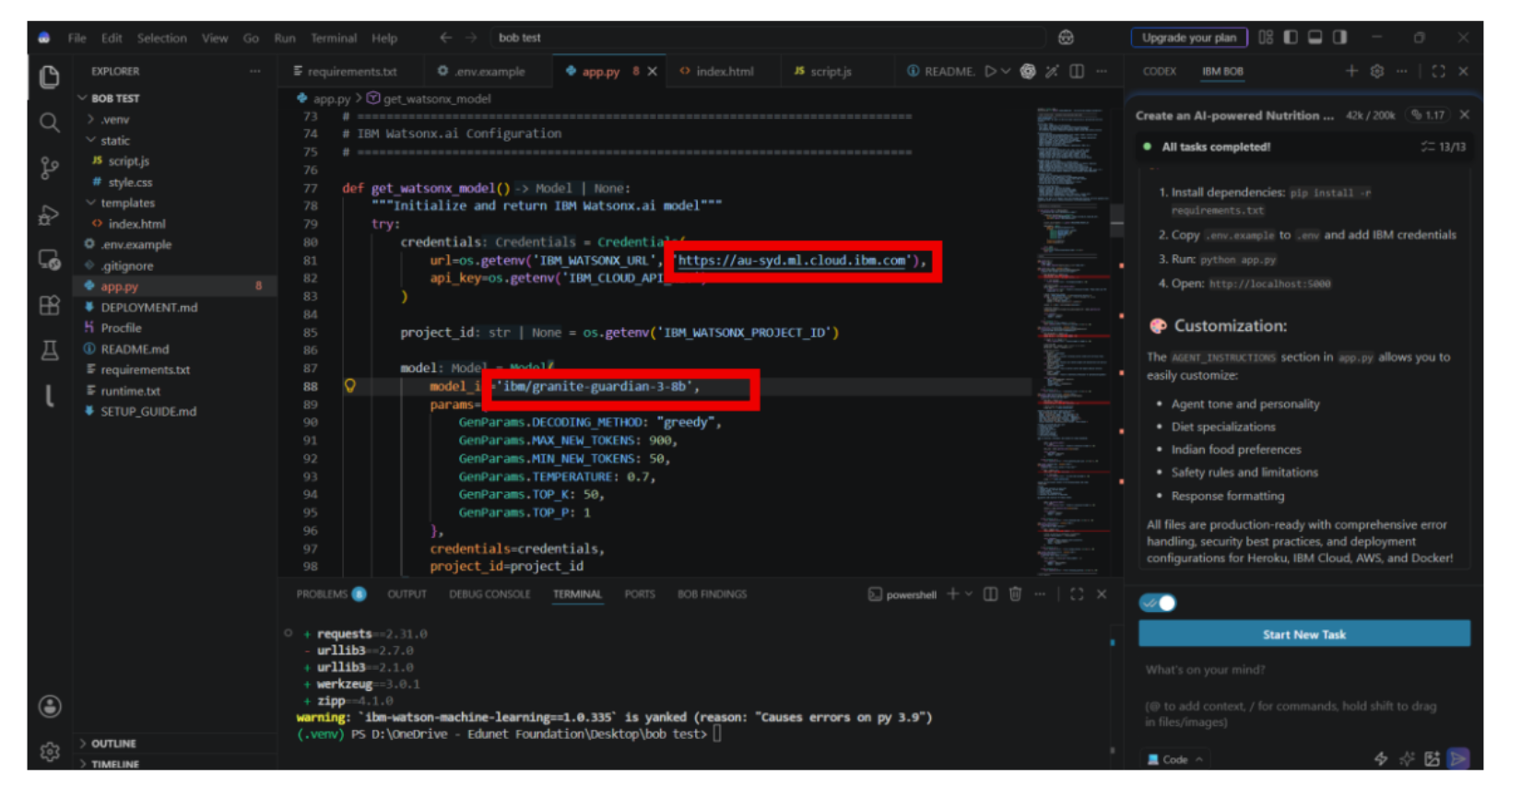

Slide 9

Role of Agentic AI in the solution
Role of Agentic AI in Mental Health Awareness & Suicide Prevention
Agentic AI enables the AI-Powered Mental Health Companion to function as an intelligent, proactive, and context-aware system rather than a traditional chatbot. By leveraging IBM watsonx.ai, IBM Granite Models, IBM Langflow/IBM Orchestrate, and Retrieval-Augmented Generation (RAG), the platform coordinates multiple specialized AI agents to deliver personalized mental wellness support.
Each AI agent performs a dedicated responsibility while collaborating with other agents to provide comprehensive assistance. The Emotion Detection Agent analyzes conversations, mood logs, and journal entries to identify emotions such as stress, anxiety, sadness, or happiness. The Mental Health Assessment Agent evaluates emotional patterns and wellness history to detect early signs of mental health concerns.
The Personalized Recommendation Agent generates tailored coping strategies, breathing exercises, meditation sessions, self-care activities, motivational content, and educational resources based on the user's emotional condition. The Risk Detection & Prevention Agent continuously monitors conversations for high-risk emotional patterns and, when necessary, provides crisis guidance while encouraging users to seek trusted human or professional support.

Slide 10
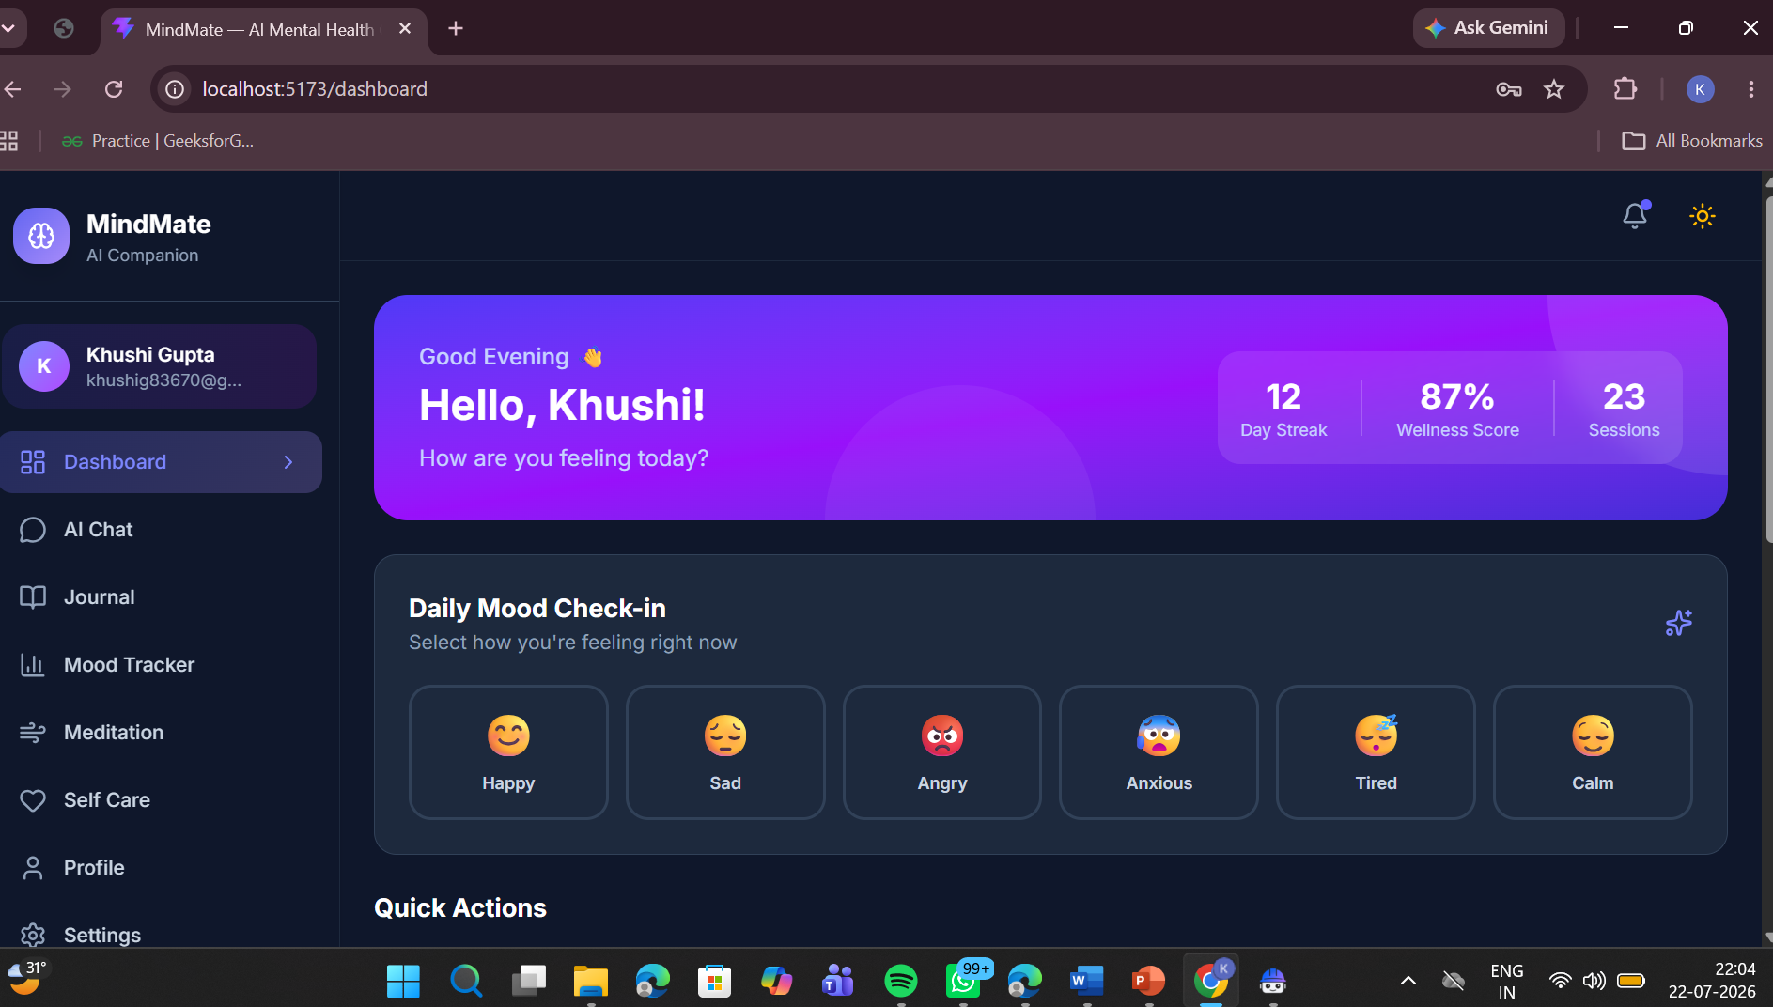
Project Output Screenshot
Please put IBM Bob output screenshots with 2-3 prompts.
You can take 2-3 more slides for each screenshot
·
·
·

Slide 11
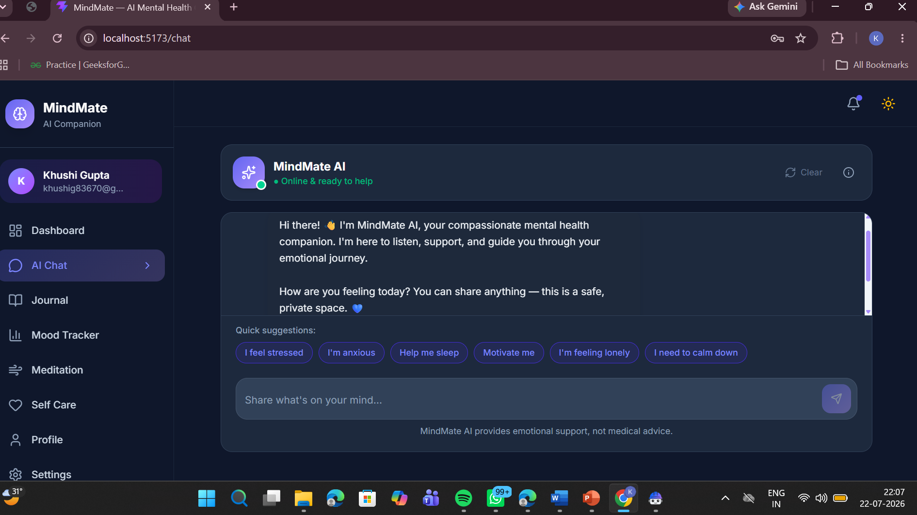
Project Output Screenshot
Please put IBM Bob output screenshots with 2-3 prompts.
You can take 2-3 more slides for each screenshot
·
·
·

Slide 12
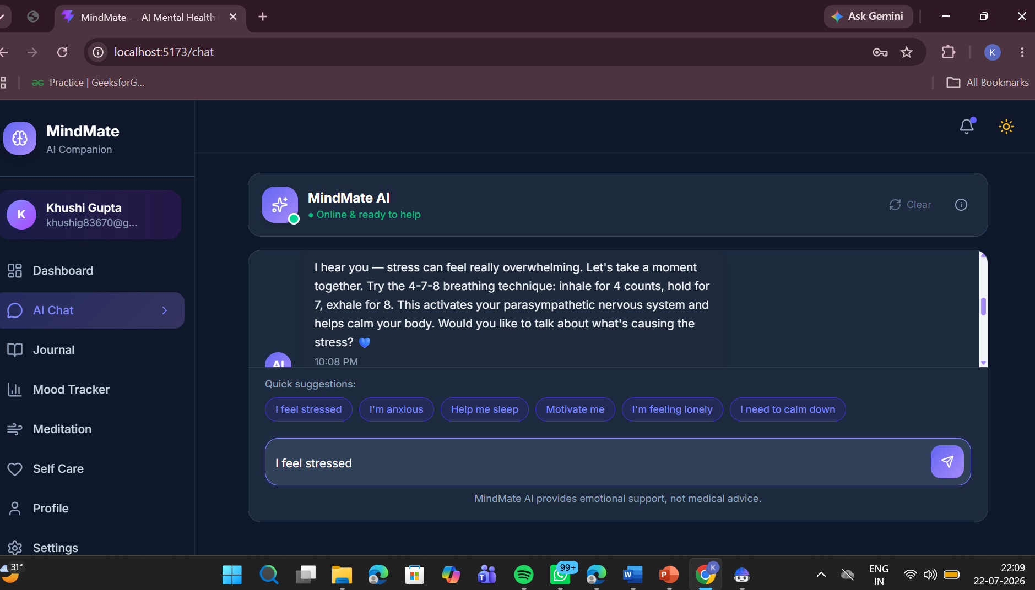
Project Output Screenshot
Please put IBM Bob output screenshots with 2-3 prompts.
You can take 2-3 more slides for each screenshot
·
·
·

Slide 13
Novelty and Uniqueness
MindMate – Agentic AI for Mental Health Awareness & Suicide Prevention platform stands out by combining Agentic AI, Retrieval-Augmented Generation (RAG), Emotion Detection, and Personalized Mental Wellness Support into a single intelligent system.
Multi-Agent Intelligence – Instead of relying on a single chatbot, multiple specialized AI agents collaborate to analyze emotions, assess mental health, detect risks, generate personalized recommendations, and provide proactive support.
RAG-Based Trusted Responses – Integrates real-time retrieval of verified mental health resources before generating responses, reducing misinformation and ensuring accurate, reliable, and evidence-based guidance.
Hyper-Personalization – Delivers personalized wellness plans, meditation sessions, breathing exercises, self-care activities, and educational content based on the user's mood history, journal entries, emotional patterns, and previous interactions.
Continuous Mood & Wellness Tracking – Maintains daily mood logs, journals, wellness scores, and emotional trends to provide meaningful insights and long-term progress monitoring.
Proactive Risk Detection & Early Intervention – Continuously analyzes conversations and behavioral patterns to identify signs of emotional distress or potential mental health risks, enabling timely support and encouraging users to connect with trusted people or professional mental health services when appropriate.

Slide 14
Git Hub Link :
https://github.com/Khushig12/MindMate-AI
·

Slide 15
Future Scope
1. Integration with Wearables & Health Devices –
The platform can be integrated with smartwatches and fitness trackers to collect real-time health data such as heart rate, sleep patterns, physical activity, and stress levels. This will enable the AI to monitor users continuously and provide more accurate mental wellness insights, personalized recommendations, and early detection of emotional distress.
2. AI-Powered Voice Assistant & Multilingual Support –
The system can be enhanced with a voice-enabled AI companion and support for multiple regional and international languages. This will improve accessibility, allowing users to interact naturally in their preferred language and making the platform more inclusive for diverse communities.
3. Predictive Mental Health Analytics –
Future versions can leverage advanced AI models to analyze long-term mood patterns, journal entries, and behavioral trends to predict potential mental health risks. This will support proactive interventions and encourage users to seek help before conditions become severe.
4.Teletherapy & Professional Support Integration –
The platform can integrate with licensed psychologists, counselors, hospitals, and telemedicine services, enabling users to schedule appointments, access online therapy sessions, and receive professional mental health support directly through the application.
·
·
·

Slide 16
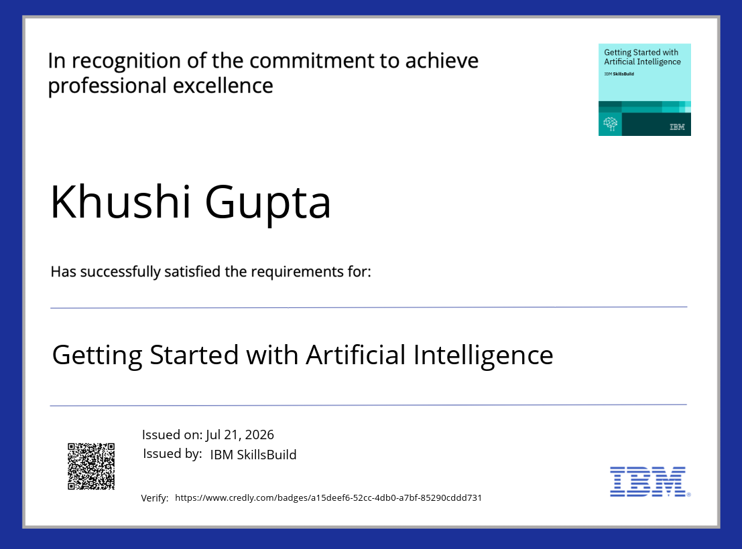
Certificates Earned:
Please add your credly certificate

Slide 17
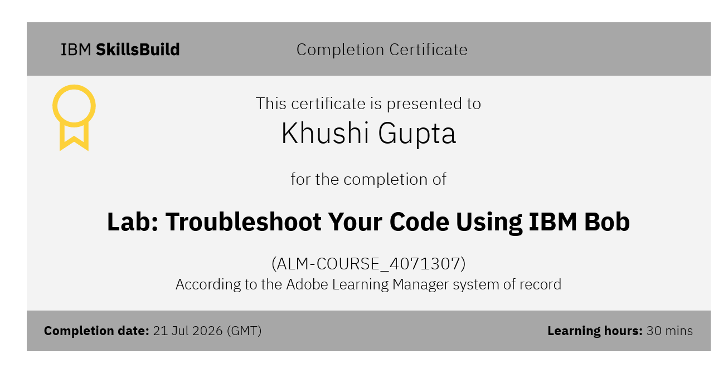
Certificates Earned:​
Add your IBM BOB Certificate

Slide 18


